Slide 1
CS 355/555
Probability and Statistics for CS
Baocheng Geng
Lecture 11, 02/15/2024
Write Programs!
CS 355/555 Probability and Statistics for CS

Slide 2



Introduction
Generating Random Numbers
Statistics
Program 1
CS 355/555 Probability and Statistics for CS

Slide 3
Copyright Statement
Copyright Statement
Materials prepared for and/or included in this course are protected by copyright law. They are intended to be used only by students enrolled in this course during the current term and should not be further disseminated without prior permission from the course instructor.
CS 355/555 Probability and Statistics for CS

Slide 4
Python calls
docs.python.org/3/library/random.html lib/random.py
random.random() - Generate random x ∈ [0, 1] random.randint(a,b) - Generate random integer random.uniform(a,b) - Generate random x ∈ [a, b] random.seed(s) - Reset seed
CS 355/555 Probability and Statistics for CS

Slide 5






Programming
Write a program to estimate π.
CS 355/555 Probability and Statistics for CS

Slide 6
Programming
Count all the points in the square, count which ones are in the circle, and divide.
CS 355/555 Probability and Statistics for CS

Slide 7
Programming
Generate random points in the square, count which ones are in the circle, and divide.
CS 355/555 Probability and Statistics for CS

Slide 8
Programming
Generate random points in the square, count which ones are in the circle, and divide.
CS 355/555 Probability and Statistics for CS
12/27 10:18

Slide 9
Programming
Generate random points in the square, count which ones are in the circle, and divide.
Count = 10,000
circleCount = 0
CS 355/555 Probability and Statistics for CS
12/27 10:18

Slide 10
Programming
Generate random points in the square, count which ones are in the circle, and divide.
Count = 10,000
circleCount = 0 Loop Count times
CS 355/555 Probability and Statistics for CS
12/27 10:18

Slide 11
Programming
Generate random points in the square, count which ones are in the circle, and divide.
Count = 10,000
circleCount = 0 Loop Count times
x = random(-1,1)
CS 355/555 Probability and Statistics for CS
12/27 10:18

Slide 12
Programming
Generate random points in the square, count which ones are in the circle, and divide.
Count = 10,000
circleCount = 0 Loop Count times
x = random(-1,1) y = random(-1,1)
CS 355/555 Probability and Statistics for CS
12/27 10:18

Slide 13
Programming
Generate random points in the square, count which ones are in the circle, and divide.
Count = 10,000
circleCount = 0 Loop Count times
x = random(-1,1) y = random(-1,1) if (x² + y²) < 1:
CS 355/555 Probability and Statistics for CS
12/27 10:18

Slide 14
Programming
Generate random points in the square, count which ones are in the circle, and divide.
Count = 10,000
circleCount = 0 Loop Count times
x = random(-1,1) y = random(-1,1) if (x² + y²) < 1:
circleCount++
CS 355/555 Probability and Statistics for CS
12/27 10:18

Slide 15









Programming
Generate random points in the square, count which ones are in the circle, and divide.
Count = 10,000
circleCount = 0 Loop Count times
x = random(-1,1) y = random(-1,1) if (x² + y²) < 1:
circleCount++
endloop
print circleCount/Count
CS 355/555 Probability and Statistics for CS
12/27 10:18

Slide 16
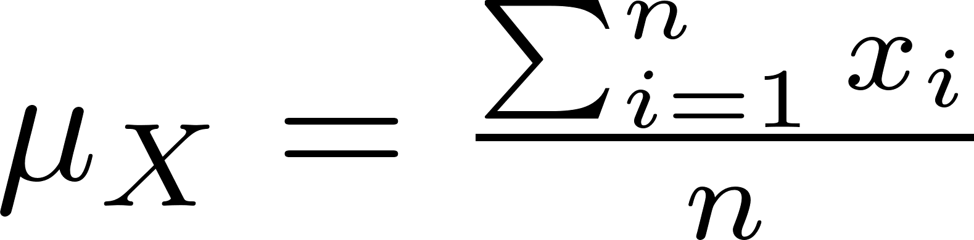
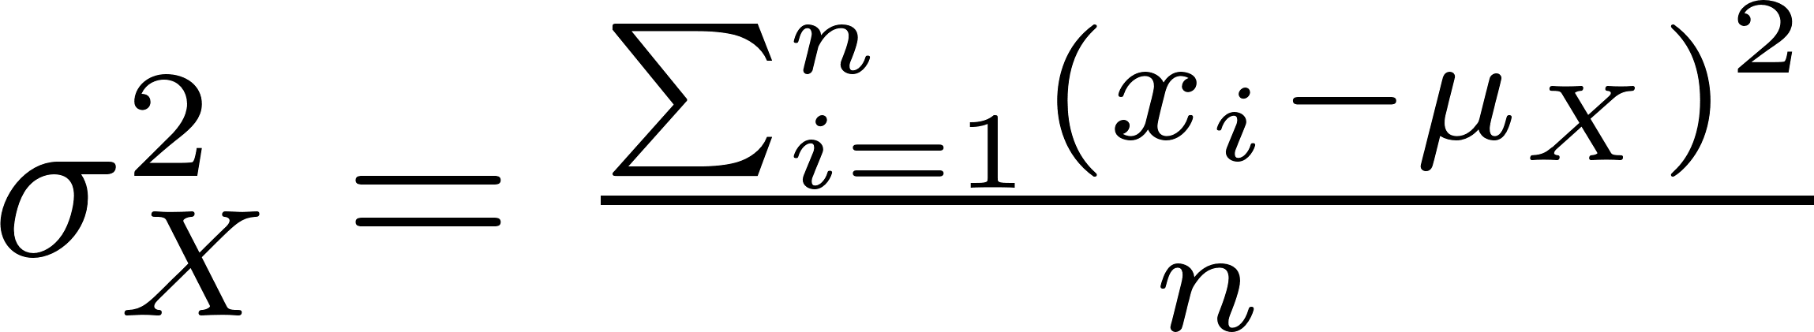
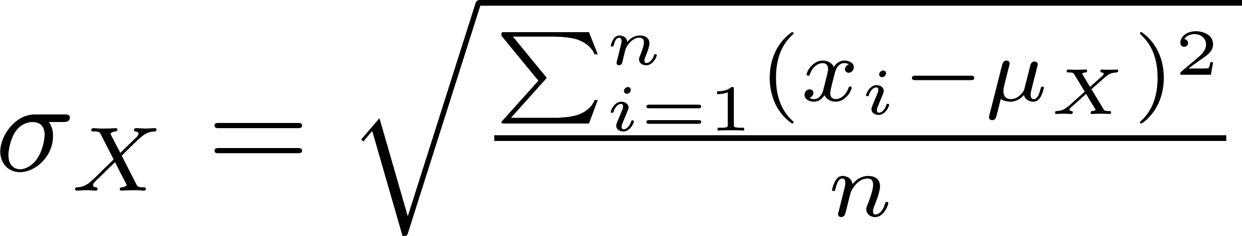

Characteristics of a Random Variable X
Mean
Variance
Standard deviation
Some new letters
µ - mu - mean (or average)
σ - sigma standard deviation
CS 355/555 Probability and Statistics for CS

Slide 17
Program 1 Random Hands in Bridge
Usually between games in poker the deck of 52 cards is shuffled three times, thinking that this will produce a randomly ordered deck, so that the hands dealt will be randomly ordered.
CS 355/555 Probability and Statistics for CS

Slide 18
Completely Random Hands
Several experiments using computer experiments to produce completely random hands have been conducted, and most of them do not produce the same results as exactly three shuffles. Most sets of hands produced by randomly generated ordering of the deck have different numbers of cards in each suit, so that 4-4-4-1 or 5-5-3-0 results are much more common.
There are various explanations for why three shuffles may or may not produce very random hands.
CS 355/555 Probability and Statistics for CS

Slide 19
Assignment
Caution! Horrendous equation on next slide!!!
CS 355/555 Probability and Statistics for CS

Slide 20
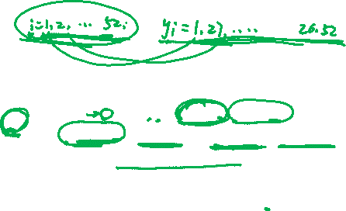
Assignment
Using a deck of cards numbered 1 - 52, shuffle the cards up to fifteen times using several different methods described below to produce a permutation of the original deck. Calling the original order i and the new deck y_{i}, calculate the following function for each of the fifteen runs.
This computation is the correlation coefficient, which we will see in more detail later in the course. The correlation coefficient is a measure of how related two sets of numbers are. If r = 0 or if r is close to 0 then the two variables are completely independent. If r = 1, then the i values and the y_{i} values are all equal, i = y_{i}. If r = −1 then the y values are backward, so that i = y_{53−i}
CS 355/555 Probability and Statistics for CS

Slide 22

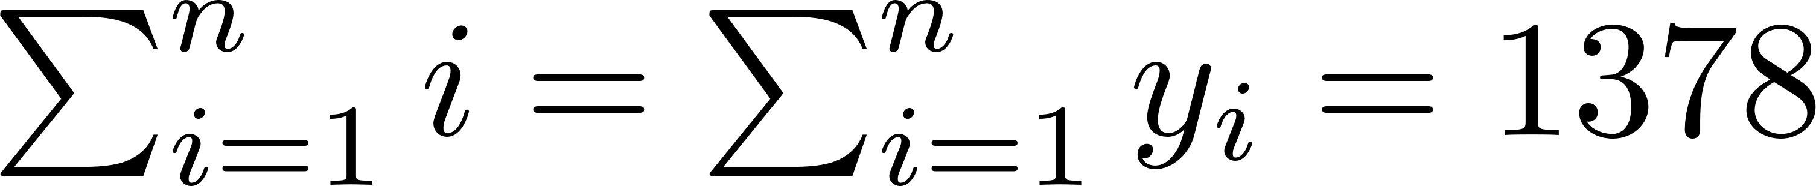
Assignment
Note that
changes from shuffle to shuffle, but all of the other
pieces of the formula remain the same since i and y are the numbers 1 through 52, and adding the digits and the squares of the digits produces the same value.
CS 355/555 Probability and Statistics for CS

Slide 23
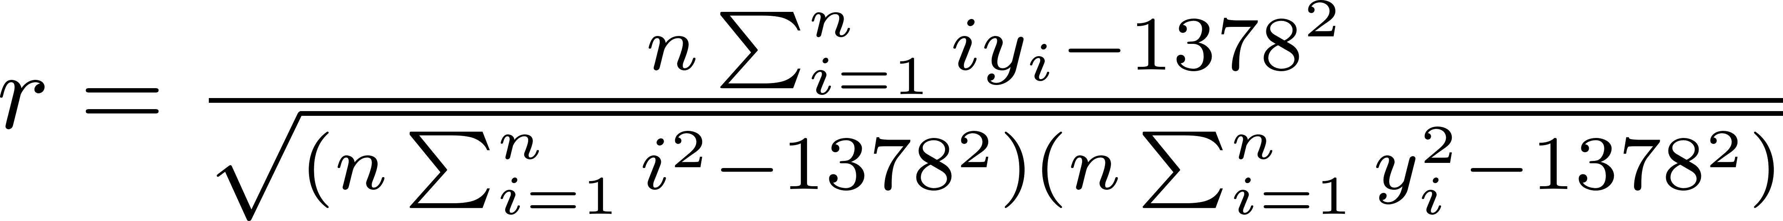
Assignment
CS 355/555 Probability and Statistics for CS

Slide 24
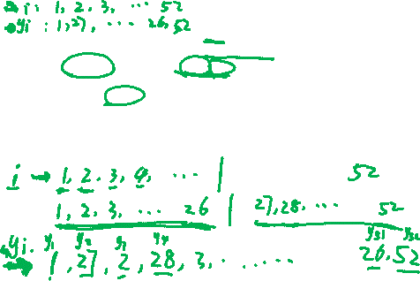
First Run
Given a deck of cards cards[] with 52 entries, produce a new deck by dividing the deck into two pieces, cards[1 − 26] and cards[27 − 52], then pick card[1], followed by card[27], followed by card[2], then card[28], etc.
Do this up to 15 times, calculating the value of r for each shuffle. Answer the following questions:
1
After how many shuffles are the cards in the most random order? (That is, when is r at a minimum value?)
CS 355/555 Probability and Statistics for CS
20/27 10:18

Slide 25
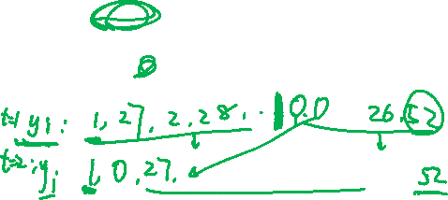
First Run
Given a deck of cards cards[] with 52 entries, produce a new deck by dividing the deck into two pieces, cards[1 − 26] and cards[27 − 52], then pick card[1], followed by card[27], followed by card[2], then card[28], etc.
Do this up to 15 times, calculating the value of r for each shuffle. Answer the following questions:
1
After how many shuffles are the cards in the most random order? (That is, when is r at a minimum value?)
Do the cards return to their original order? After how many shuffles?
2
CS 355/555 Probability and Statistics for CS
20/27 10:18

Slide 26
First Run
Given a deck of cards cards[] with 52 entries, produce a new deck by dividing the deck into two pieces, cards[1 − 26] and cards[27 − 52], then pick card[1], followed by card[27], followed by card[2], then card[28], etc.
Do this up to 15 times, calculating the value of r for each shuffle. Answer the following questions:
1
After how many shuffles are the cards in the most random order? (That is, when is r at a minimum value?)
Do the cards return to their original order? After how many shuffles?
Is a total of 15 shuffles enough to return to the original order?
2
3
CS 355/555 Probability and Statistics for CS
20/27 10:18

Slide 27
First Run
Given a deck of cards cards[] with 52 entries, produce a new deck by dividing the deck into two pieces, cards[1 − 26] and cards[27 − 52], then pick card[1], followed by card[27], followed by card[2], then card[28], etc.
Do this up to 15 times, calculating the value of r for each shuffle. Answer the following questions:
1
After how many shuffles are the cards in the most random order? (That is, when is r at a minimum value?)
Do the cards return to their original order? After how many shuffles?
Is a total of 15 shuffles enough to return to the original order?
If not, does it appear that the cards will return to their original order in a relatively small number of shuffles?
2
3
4
CS 355/555 Probability and Statistics for CS
20/27 10:18

Slide 28
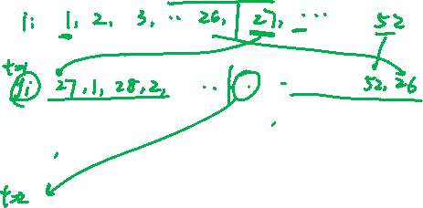
Second Run
In the First Run, the first card will always be 1 and the last card will always be 52. Change the shuffling so that the first card in the next deck is card[27], the second card is card[1], etc., so that the last two cards are card[52] followed by card[26]. Answer the same questions as in the First Run.
CS 355/555 Probability and Statistics for CS

Slide 29
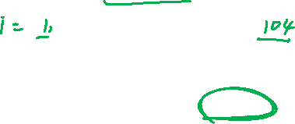
Repeat the First Run with a deck of cards with 104 members.
Third Run
CS 355/555 Probability and Statistics for CS

Slide 30
Repeat the Second Run with a deck of cards with 104 members.
Fourth Run
CS 355/555 Probability and Statistics for CS

Slide 31
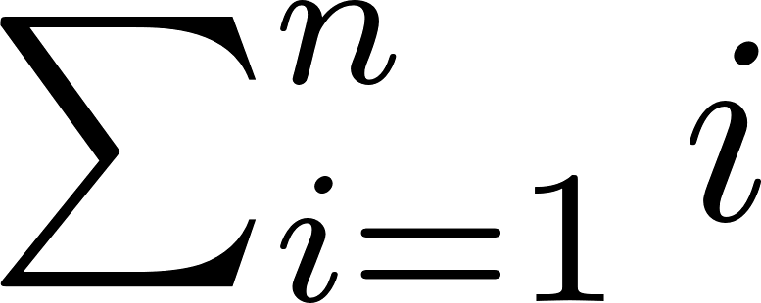

Programming Style for the Computation of r
As noted above, when writing the program for the first run you can
substitute 1378 for
and for
. If you do this, you will
have to recalculate by hand for the runs with 104 cards.
You could define a variable with a name like sumi and set sumi =1378
then use sumi for
and for
CS 355/555 Probability and Statistics for CS
24/27 10:18

Slide 32
Programming Style for the Computation of r
As noted above, when writing the program for the first run you can
substitute 1378 for
and for
. If you do this, you will
have to recalculate by hand for the runs with 104 cards.
You could define a variable with a name like sumi and set sumi =1378
then use sumi for
and for
Similarly, calculate sumisq.
CS 355/555 Probability and Statistics for CS
24/27 10:18

Slide 33
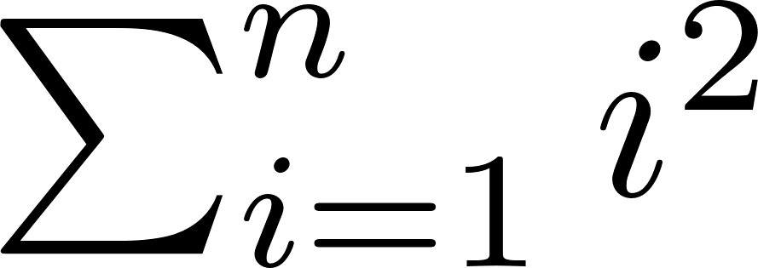
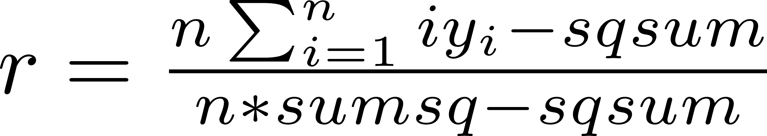

Some Good Advice
Close to the first line of the program, set a value n = 52. Then, right
after that, calculate sumi = and sumsq = using correct
Python syntax, of course). Then set sqsum = sumi ∗ sumi. This
reduces the computation of r to
CS 355/555 Probability and Statistics for CS
26/27 10:18

Slide 34
Some Good Advice
Close to the first line of the program, set a value n = 52. Then, right
after that, calculate sumi = and sumsq = using correct
Python syntax, of course). Then set sqsum = sumi ∗ sumi. This
reduces the computation of r to
Then, just change 52 to 104.
CS 355/555 Probability and Statistics for CS
26/27 10:18

Slide 35
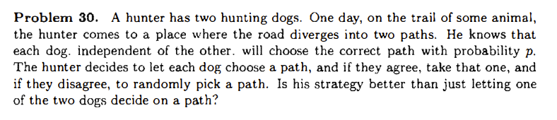

Slide 36
